Slide 1
Implementation of GPT models for Text Generation in Health Care domain
By Anirban Karak
Mtech May’21 WE

Slide 2
Abstract
This paper highlights the potential of using generalized language models to extract structured texts from natural language descriptions of workflows in various industries like healthcare domain. Despite the criticality of these workflows to the business, they are often not fully automated or formally specified. Instead, employees may rely on natural language documents to describe the procedures. Text generation methods offer a way to extract structured plans from these natural language documents, which can then be used by an automated system. This paper explores the effectiveness of using generalized language models, such as GPT-2, to perform text generation directly from these texts. These models have already shown success in multiple text generation tasks, and the paper's initial results suggest that they could also be effective in text generation in healthcare domain. In fact, the paper demonstrates that GPT-2 can generate results that are comparable to many current state-of-the-art text generation methods. This suggests that generalized language models have the potential to significantly improve the efficiency and accuracy of text generation, particularly in industries where workflows are repetitive and sequential.

Slide 3
Introduction
Lifestyle diseases are continuously on the rise, due to the sedentary lifestyle of human beings, in today’s world.
It is very difficult for doctors/healthcare professionals to remember the name of medicines since they treat thousands of patients daily.
To overcome this issue, in this paper, I tried to explore the possibility that given a medicine name as an input, the ability of GPT-2 to correctly generate text based on the usage of the medicine.
The focus of this research paper is to explore the potential of utilizing GPT-2, a cutting-edge transformer-based language model, for generating text given an input, in minimal time with better accuracy.

Slide 4

Literature Survey
DistilGPT2 (short for Distilled-GPT2) is an English-language model pre-trained with the supervision of the smallest version of GPT-2.
Like GPT-2, DistilGPT2 can be used to generate text.
The importance of text generation is due to several reasons, including the retrieval of significant information from a text within a short period.
Since DistilGPT2 is a distilled version of GPT-2, it is intended to be used for similar use cases with the increased functionality of being smaller and easier to run than the base model.

Slide 5
My Contribution
I have used BERT tokenizer for tokenize the data and did POS tagging to create a custom vocabulary which helps the GPT2 model in training
I implemented special coefficient for calculating the language model loss and multiple-choice loss and calculated total loss
Finally, I used grad accumulation to improved the total loss

Slide 6
Expected Outcome:
The expectation from this model is to generate relevant and concise text regarding the usage of the medicine, when input given to the model is a medicine name.
The model should not generate repetitive text.
Model will generate top five sentences relevant to the input (medicine name).

Slide 7
Algorithm:
Collect the PubMed (medicine) data.
Process the raw data (null removal, special character removal, emoji removal etc).
Tokenize the process data.
Create training and validation dataset from tokenized data.
Create the segment tokens.
Return the last token before the padding.
For better result shuffle the tuple.
Create the tensor object for GPT-2 model.
Load the pretrained Distill GPT-2 model.
Add the special token using GPT-2 tokenizer.
Resize the tokens embedding as GPT-2 supports max length of 1024.
Load the previously saved tensor data using data loader and passing to the GPT2 model for training.
Fine tune the GPT-2 model using hyperparameter tuning.
GPT-2 takes the input text such as medicine name and generate the text.

Slide 8
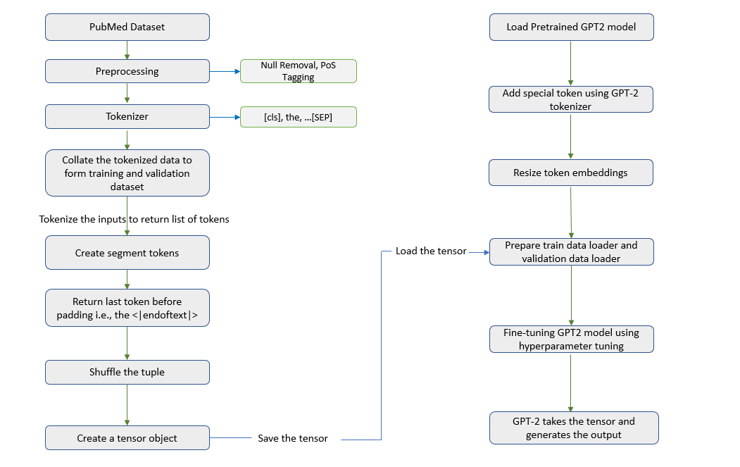
Block diagram of the model

Slide 9
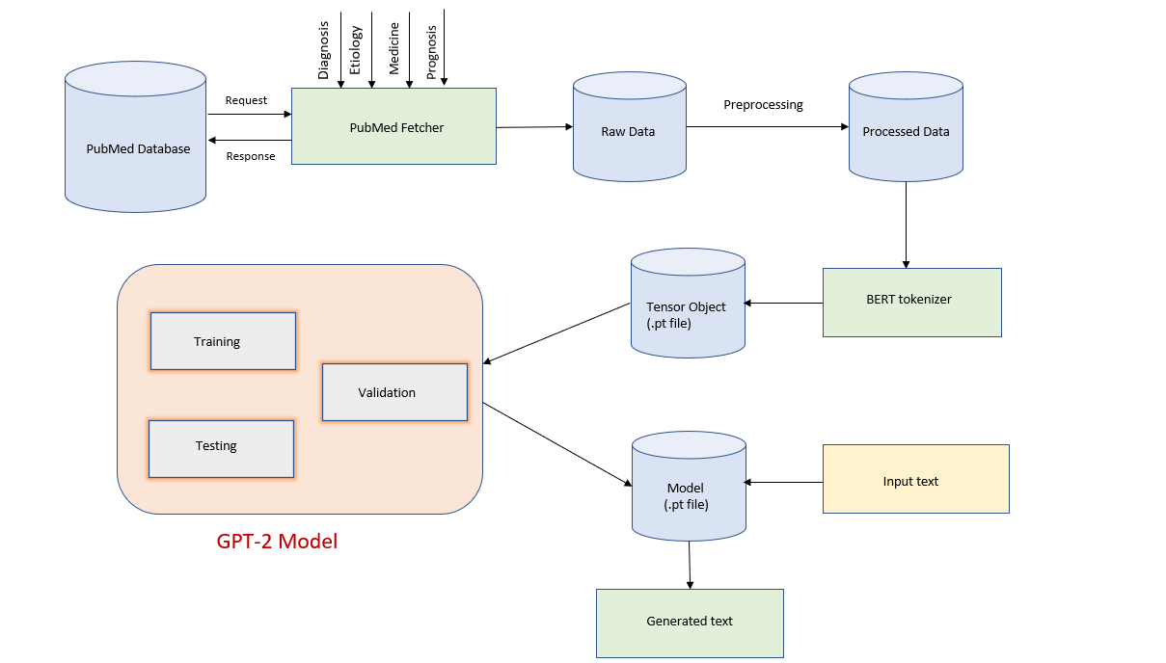
Architecture diagram

Slide 10
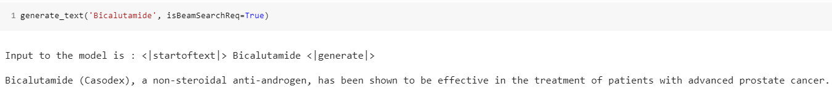
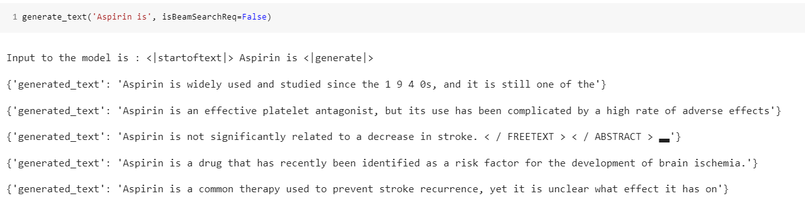
Results:
with Beam Search:
with Sampling:

Slide 11
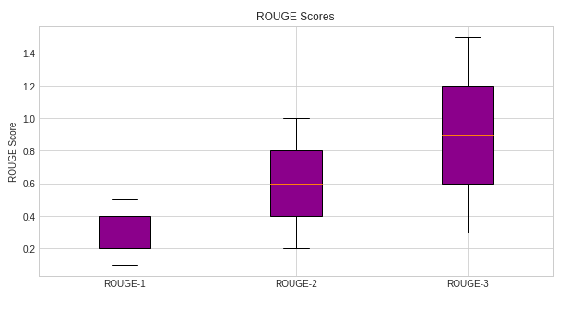
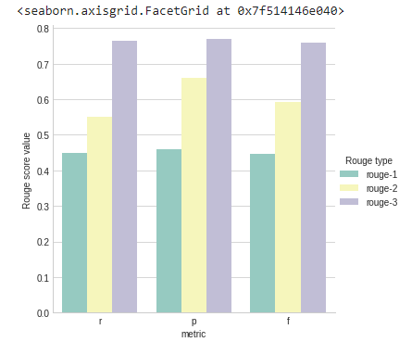
Performance Evaluation:

Slide 12
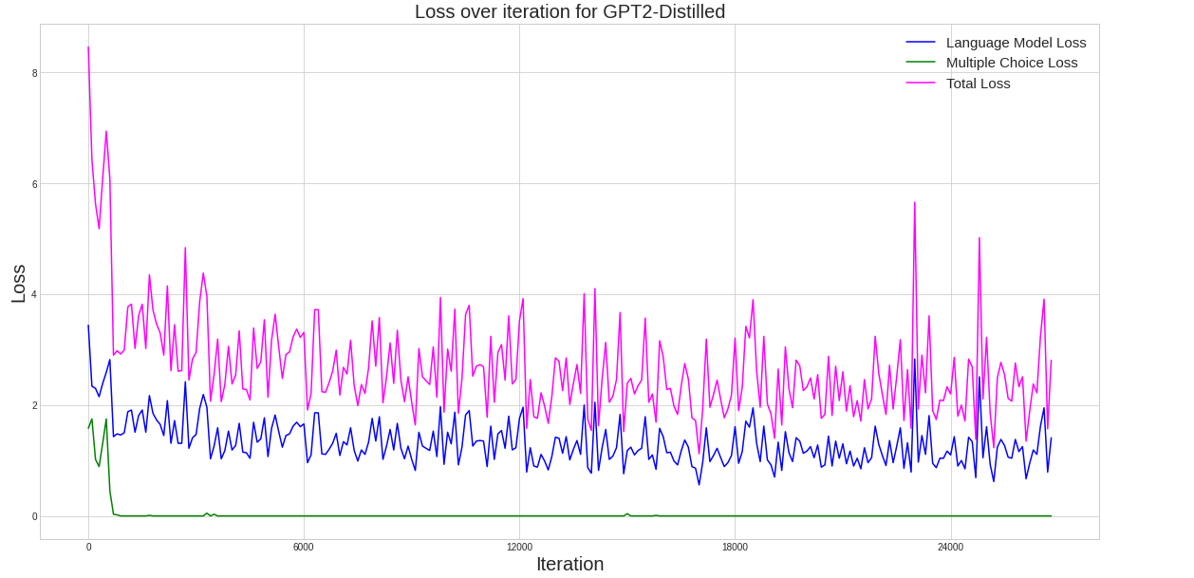
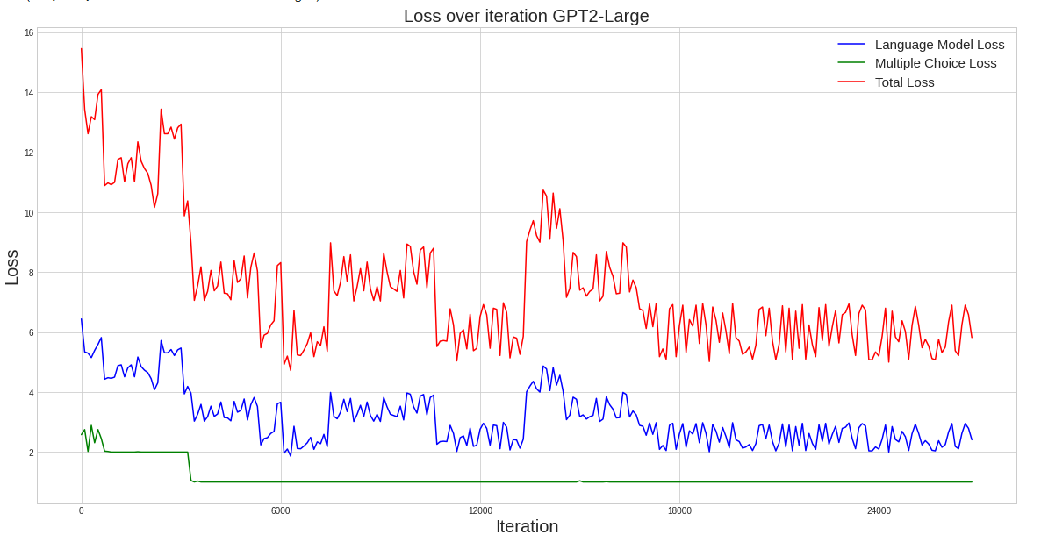
Model Comparison:

Slide 13
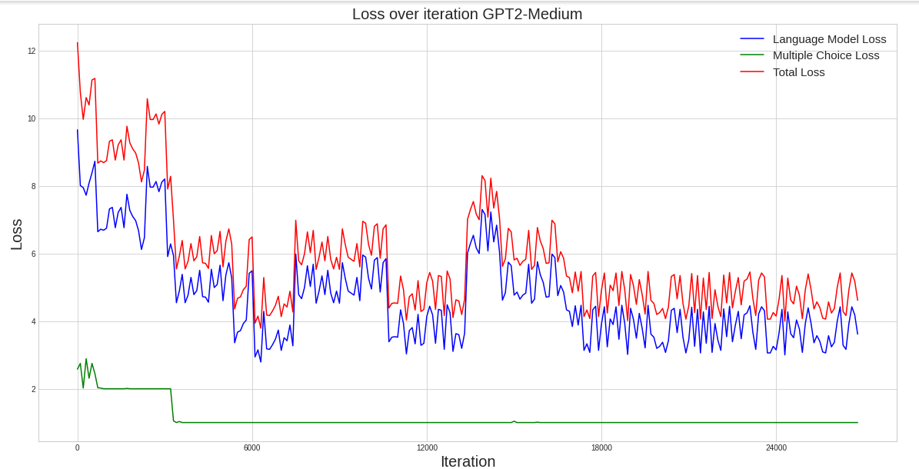
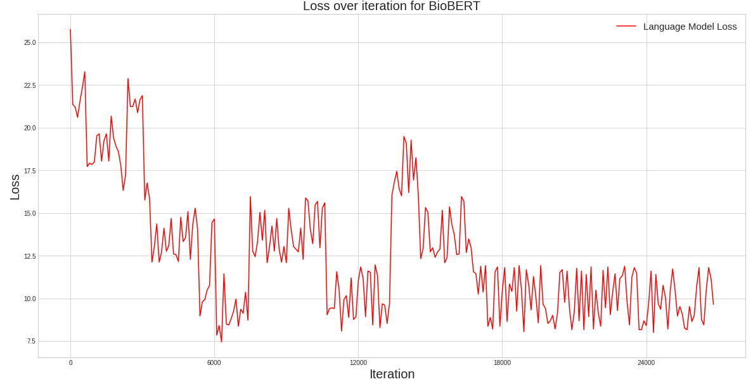
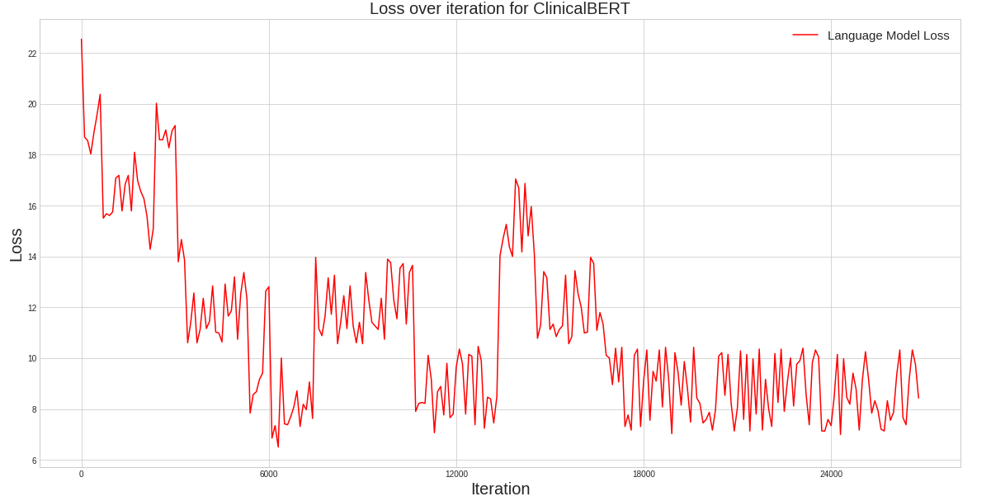
Model Comparison – continued:

Slide 14
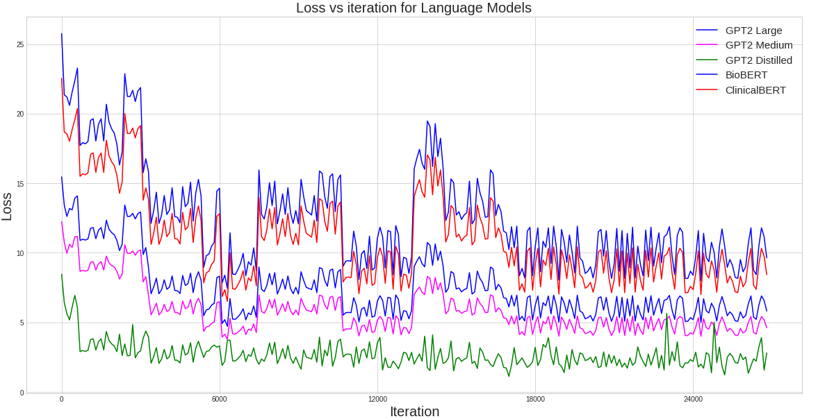
Model Comparison – continued:

Slide 15
References
Addis, A.; and Borrajo, D. 2010. From unstructured web knowledge to plan descriptions. In Information Retrieval and Mining in Distributed Environments, 41–59. Springer.
Branavan, S.; Chen, H.; Zettlemoyer, L.; and Barzilay, R. 2009. Reinforcement Learning for Mapping Instructions to Actions. In Proceedings of the Joint Conference of the 47th Annual Meeting of the ACL and the 4th International Joint Conference on Natural Language Processing of the AFNLP, 82–90. Suntec, Singapore: Association for Computational Linguistics. URL https://www.aclweb.org/anthology/P09- 1010.
Brown, T.; Mann, B.; and et al., R. 2020. Language Models are Few-Shot Learners. In Larochelle, H.; Ranzato, M.; Hadsell, R.; Balcan, M. F.; and Lin, H., eds., Advances in Neural Information Processing Systems, volume 33, 1877–1901. Curran Associates, Inc. URL https://proceedings.neurips.cc/paper/2020/file/ 1457c0d6bfcb4967418bfb8ac142f64a-Paper.pdf.
Daniele, A. F.; Bansal, M.; and Walter, M. R. 2017. Navigational instruction generation as inverse reinforcement learning with neural machine translation. In 2017 12th ACM/IEEE International Conference on Human-Robot Interaction (HRI, 109–118. IEEE.
Feng, W.; Zhuo, H. H.; and Kambhampati, S. 2018. Extracting action sequences from texts based on deep reinforcement learning. arXiv preprint arXiv:1803.02632 .

Slide 16
URL of base paper
https://arxiv.org/abs/2006.01997
Base paper code URL:
https://github.com/VincentK1991/BERT_summarization_1

Slide 17

Thank You!

